Slide 1
Paper ID:154
A Game-Theoretic Framework for Hydrogen Integration to Accelerate Energy Transitions in Great Britain
Mohamed Abuella¹, Adib Allahham¹, Sara Louise Walker²
¹ Northumbria University, UK ² University of Birmingham, UK

Slide 2

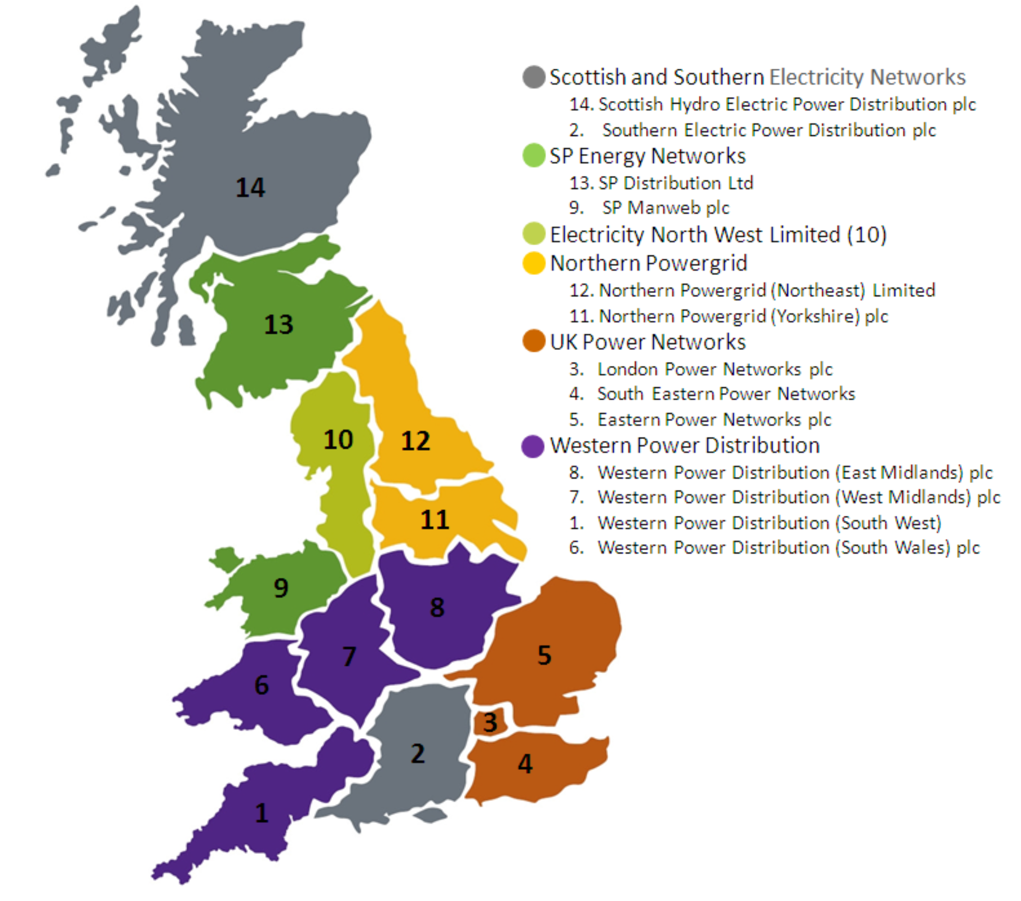
A Game-Theoretic Framework for Hydrogen Integration to Accelerate Energy Transitions in Great Britain
Objective:
To assess the optimal strategies for decarbonizing the GB’s energy system, with focus on hydrogen integration.
Research Questions:
What are the optimal strategies for incorporating hydrogen into existing energy systems?
How can hydrogen contribute to decarbonisation across electricity, heating, and transportation?
What are the economic and technical challenges of hydrogen integration?
How can optimisation models address these challenges and identify pathways for hydrogen integration?
Zones of the DNOs in the GB

Slide 3
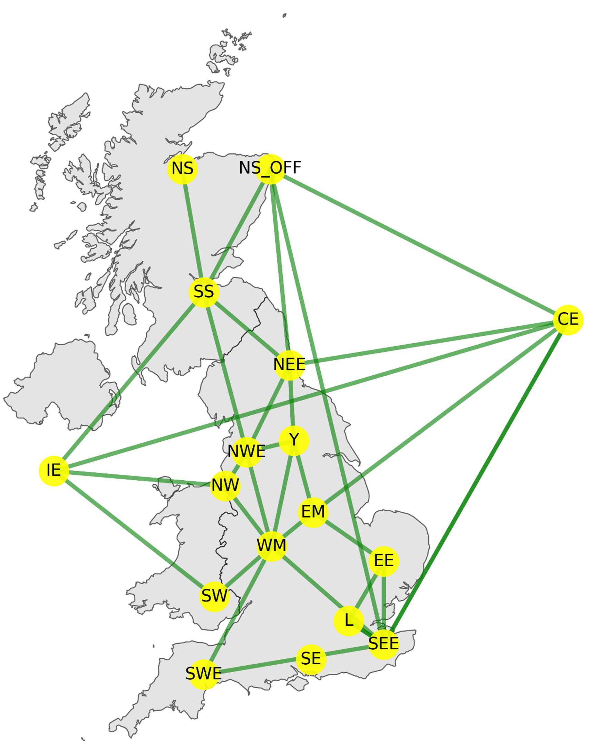
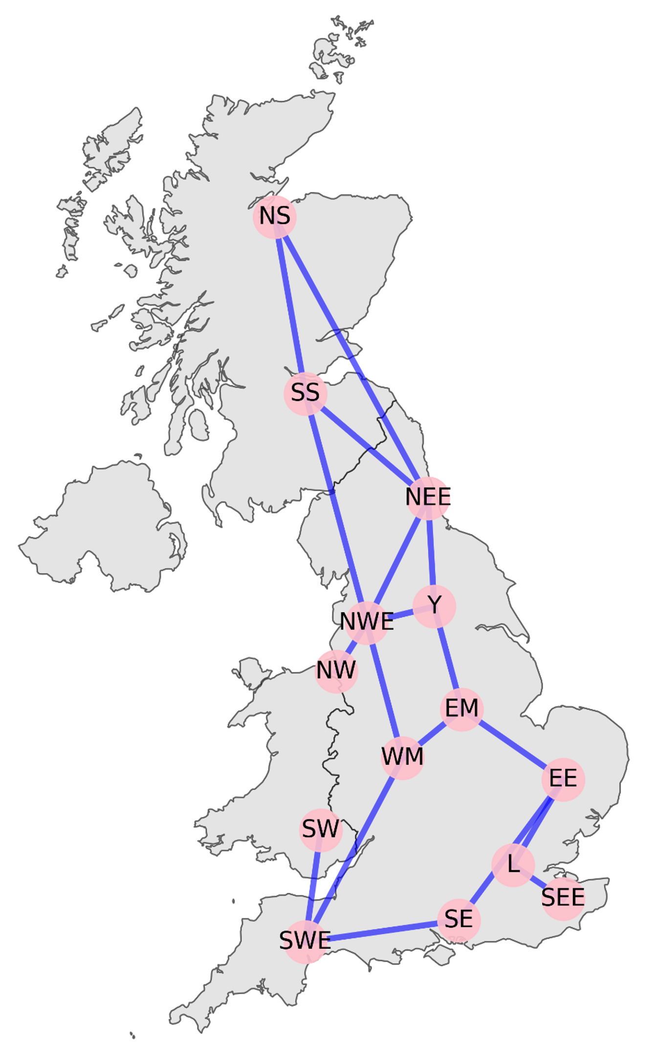
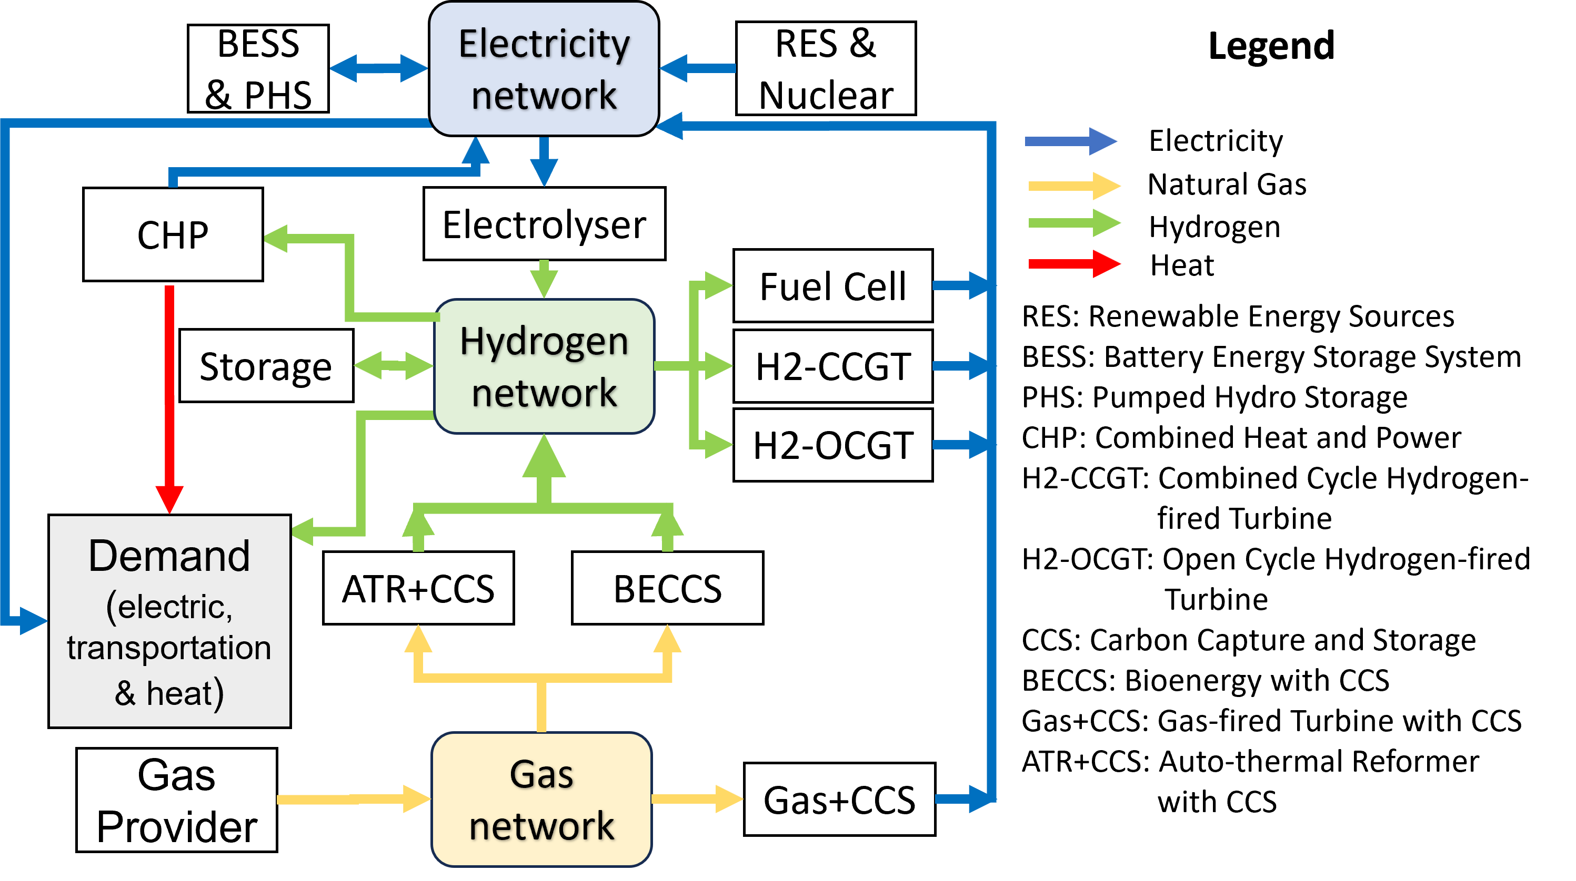
System Description:
The GB’s energy systems networks: Electricity and gas/hydrogen networks have been built using pandapower and pandapipes, and Pyomo in Python.
Integrated multi-vector energy system framework
Electricity Network
Gas/Hydrogen Network

Slide 4
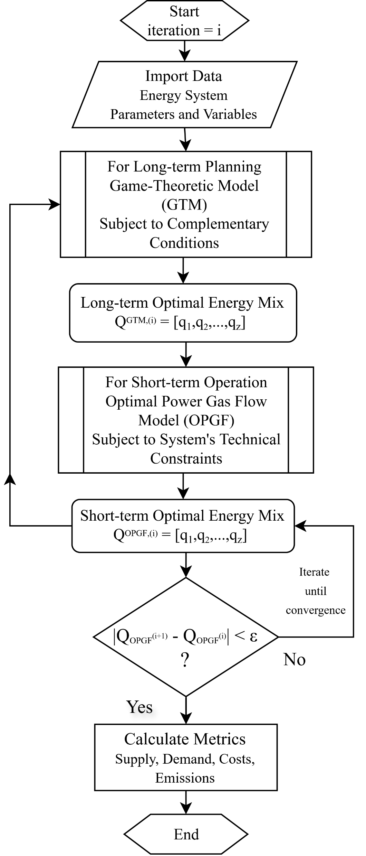
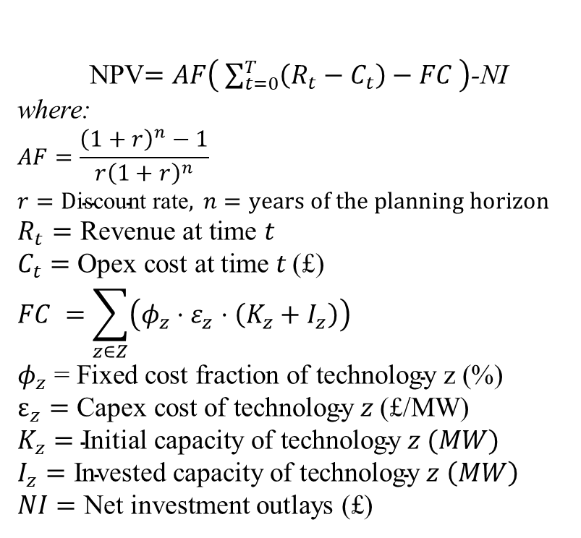
Methodology: Modelling Long-term Planning & Short-term Operation
Forms the foundational optimization layer for the multilevel optimization framework, which incorporates short-term operation (OPGF) and long-term planning (game-theoretic model) to achieve GB's net-zero by 2050.
We solve for a Nash-Cournot Equilibrium, where no single player can improve their outcome by unilaterally changing their investment strategy.
Each player's decision is driven by maximizing their Net Present Value (NPV).
NPV$=AF\left( \sum_{t=0}^{T}{\left(R_{t}−C_{t}\right)−FC }\right)$-NI
where:
$$AF=\frac{{\left(1+r\right)}^{n}−1}{r{\left(1+r\right)}^{n}}$$
$$r=\text{D}\text{iscount} \text{rate}, n=years of the planning horizon$$
$$R_{t}=\text{Revenue} \text{at} \text{time} t$$
$$C_{t}=\text{Opex} \text{cost} \text{at} \text{time} t \text{(£)}$$
$$FC =\sum_{z∈Z}{\left(φ_{z}⋅ε_{z}⋅\left(K_{z}+I_{z}\right)\right)}$$
$$φ_{z}\text{ = }\text{Fixed} \text{cost} \text{fraction} \text{of} \text{technology} \text{z}\text{ (\%) }$$
$$ε_{z}=\text{Capex} \text{cost} \text{of} \text{technology} z \text{(£/}\text{MW}\text{)}$$
$$K_{z}=\text{Initial} \text{capacity} \text{of} \text{technology} z (MW)$$
$$I_{z}=\text{Invested} \text{capacity} \text{of} \text{technology} z \left(MW\right)$$
$$NI=\text{Net} \text{investment} \text{outlays}\text{ (£)}$$
Framework Flowchart

Slide 5
Simulation
Installed capacity settings for four investment scenarios in 2050, with 2025 as baseline capacities.
The electric peak demand is 102.17GWh, while hydrogen peak demand=14.27 GWh.
Technology | 2025 (GW) | 2050 Scenarios (GW)
 |  | Uniform +25GW/Tech. | High RES–High H₂ | High RES–Low H₂ | High H₂–Low BESS
Nuclear | 6.8 | 31.8 | 25 | 25 | 25
Wind (offshore, onshore) | 31 | 81 | 100 | 100 | 150
Solar (PV) | 17 | 42 | 70 | 70 | 110
BESS | 3 | 28 | 60 | 60 | 10
Others | >25 | >25 | >25 | >25 | >25
G2P (H2-CCGT) | 0 | 25 | 10 | 0.5 | 25
G2P (H2-OCGT) | 0 | 25 | 10 | 0.5 | 25
G2P (Fuel Cell) | 0 | 25 | 10 | 0.5 | 25
P2G (Electrolyser) | 0.5 | 25.5 | 20 | 0.5 | 25
G2G (ATR+CCS, BECCS) | 0 | 25 | 15 | 0.5 | 25

Slide 6
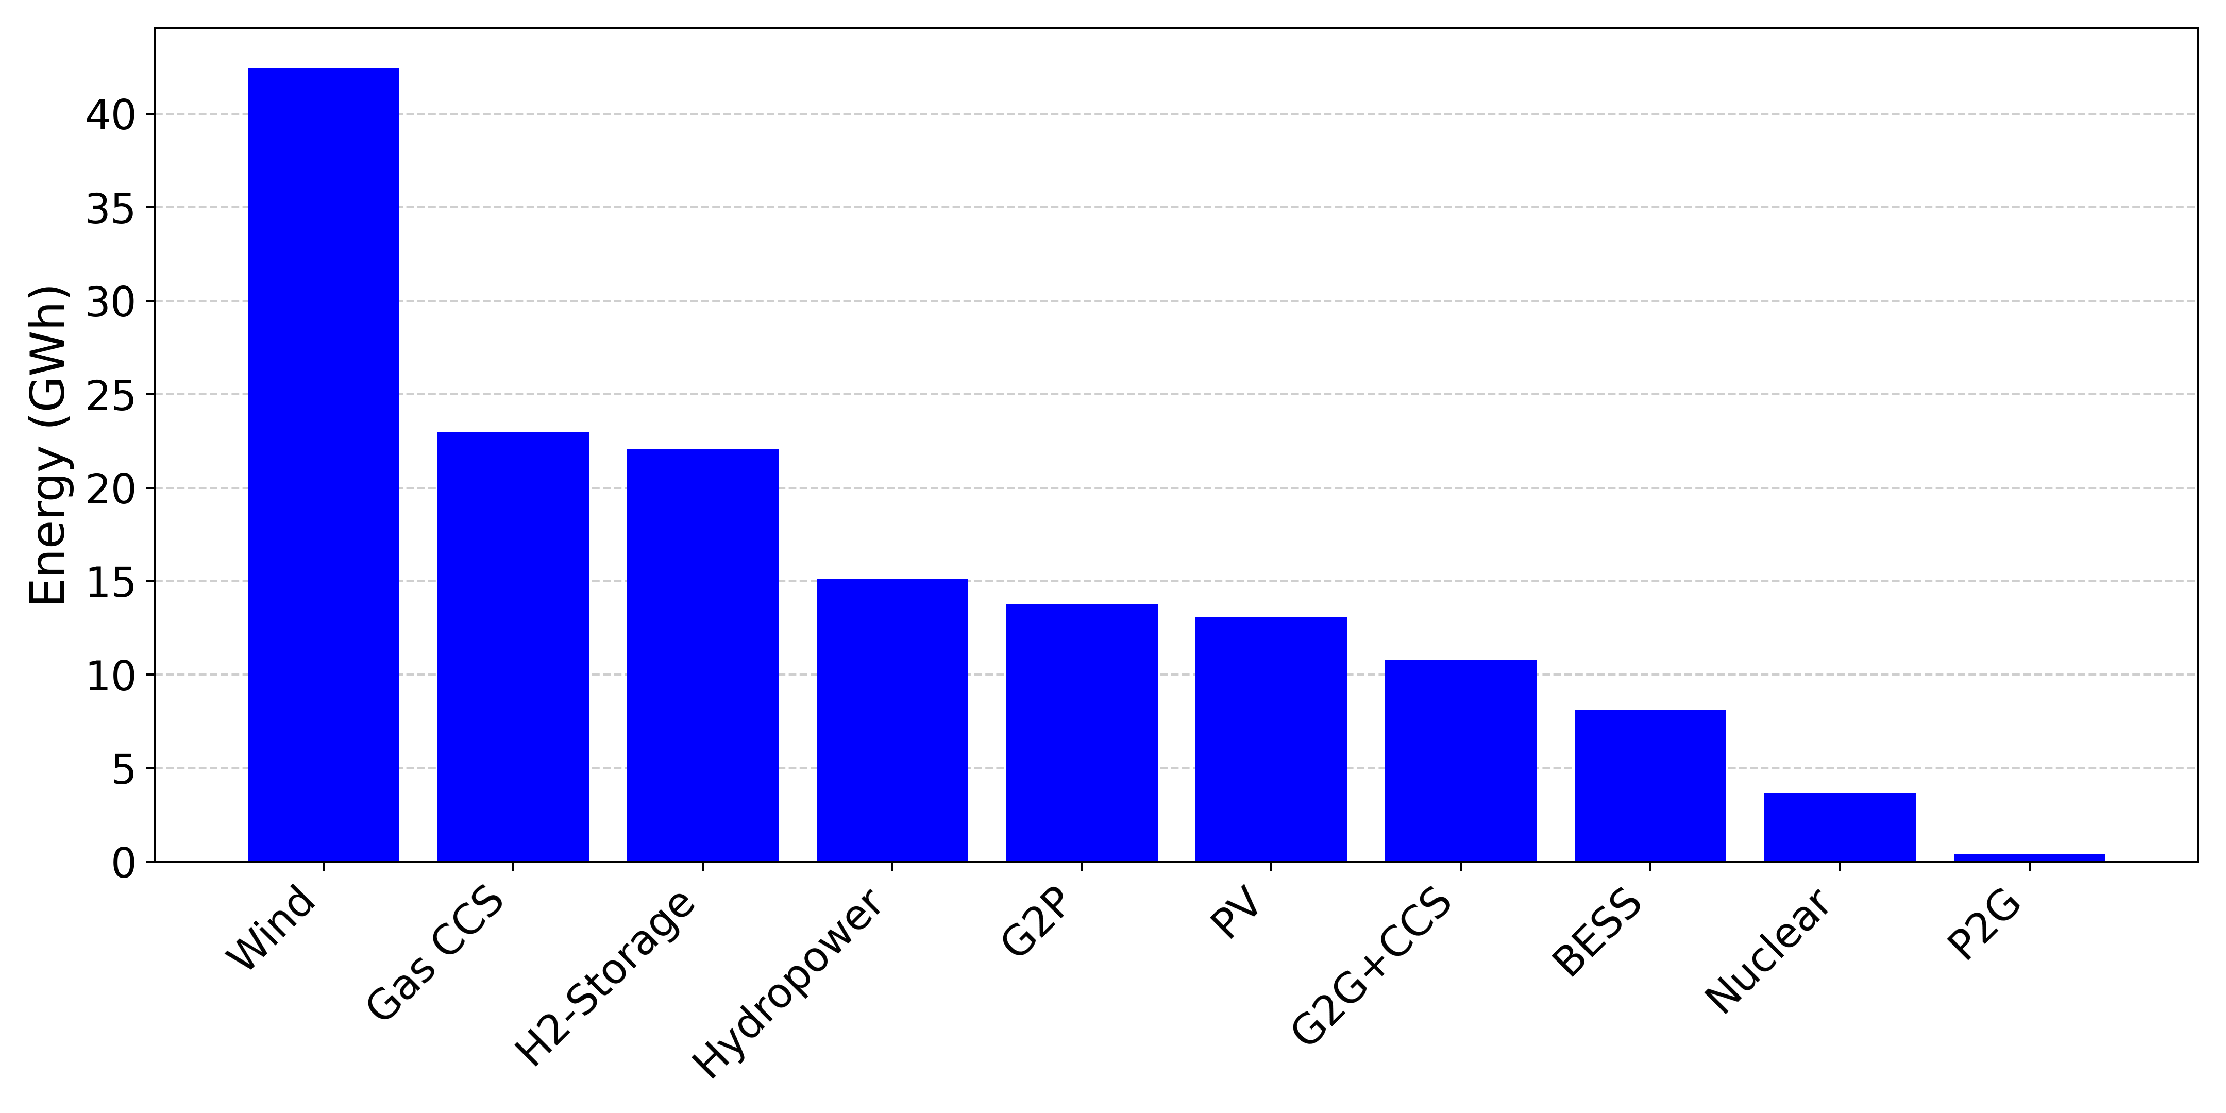
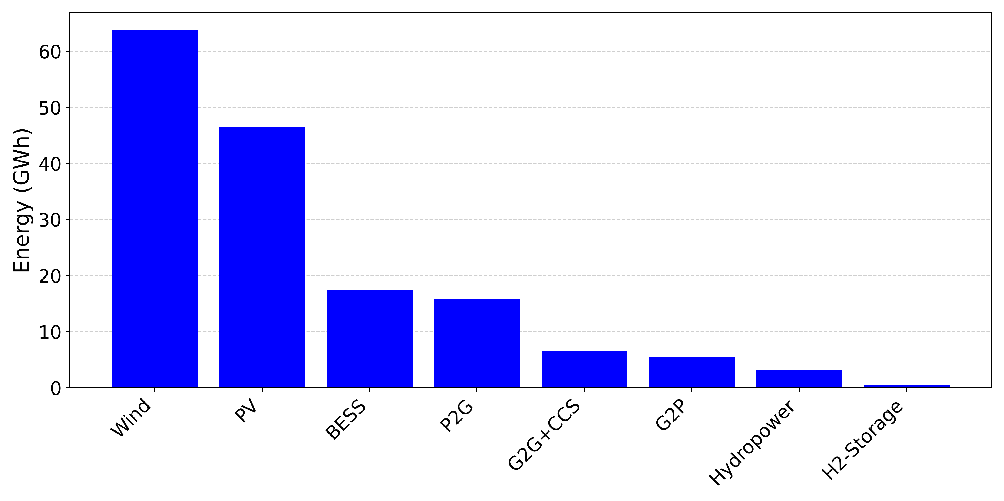
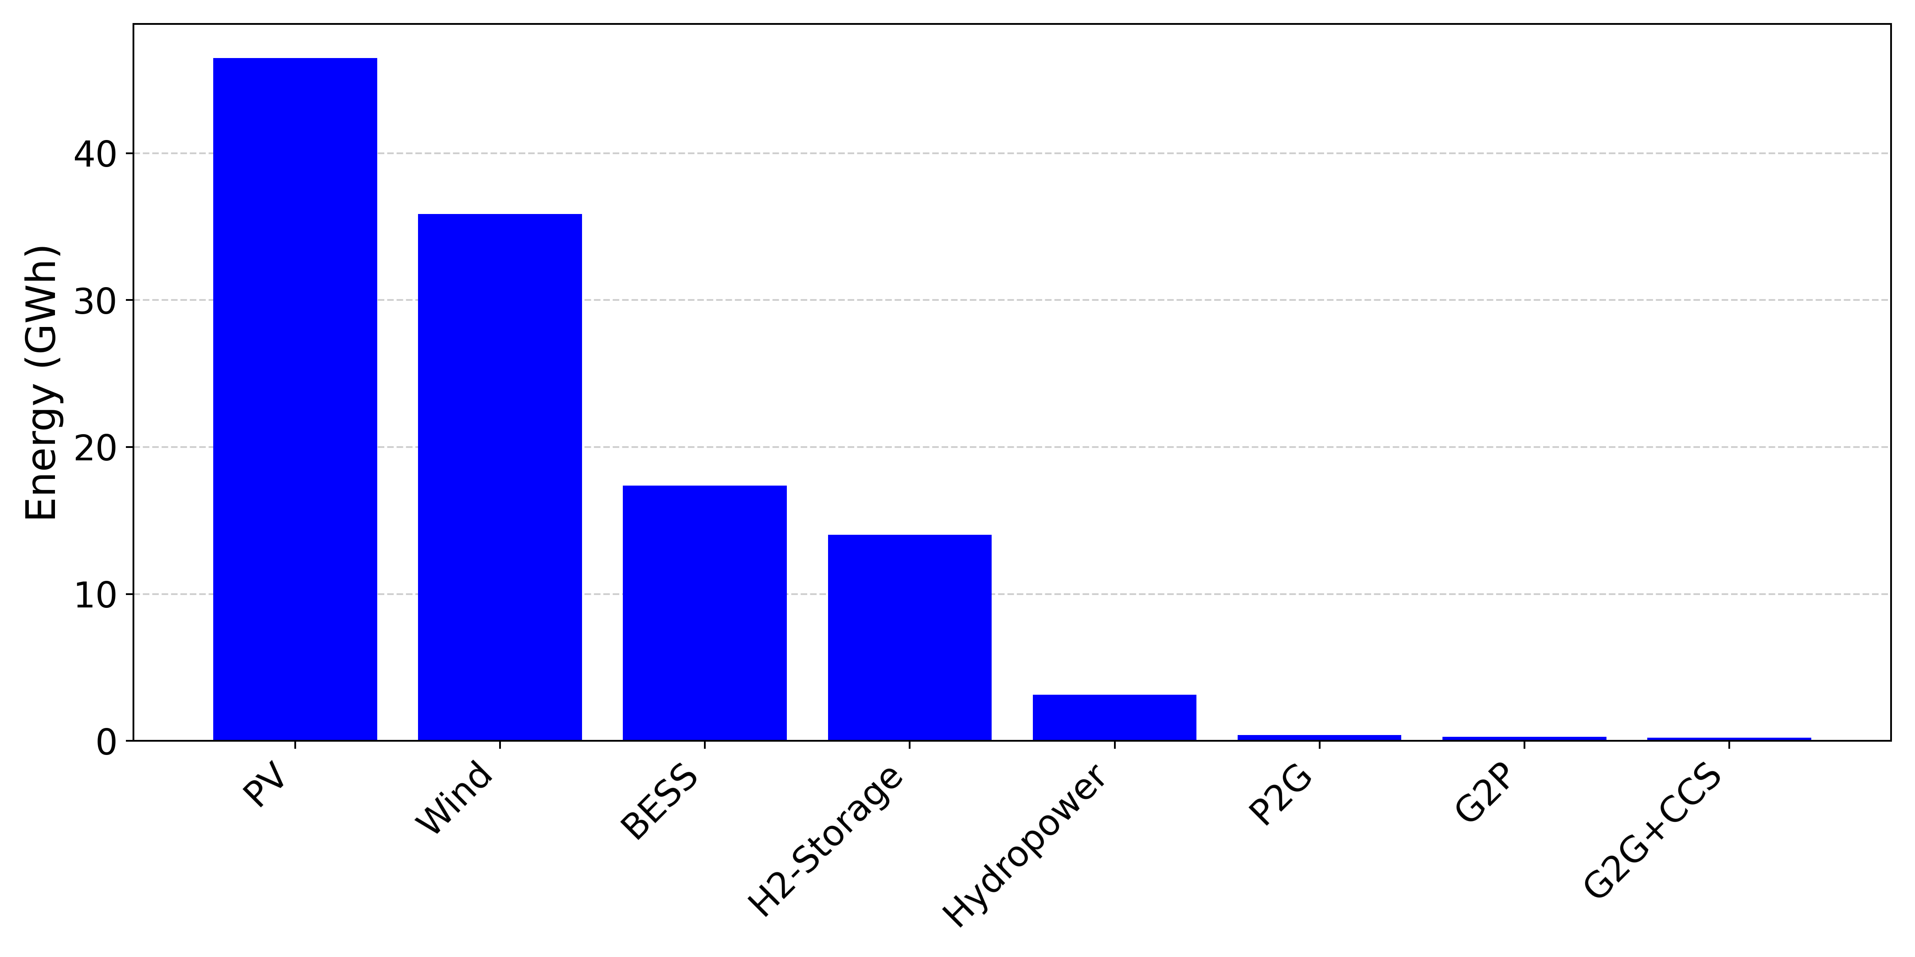
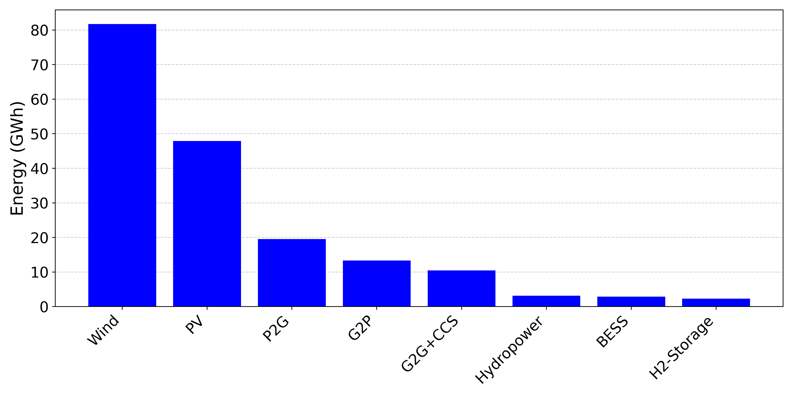
Results
2025-2050 Planning
The electric peak demand is 102.17GWh, while hydrogen peak demand=14.27 GWh.
Uniform +25GW/Tech.
High RES–High H₂
High RES–Low H₂
High H₂–Low BESS

Slide 7
Results
Simulation results for 2050 peak demand under different capacity allocation scenarios.
The electric peak demand is 102.17GWh, while hydrogen peak demand=14.27 GWh.
Metric | Uniform +25GW/Tech. | High RES–High H₂ | High RES–Low H₂ | High H₂–Low BESS
Total Demand (GWh) | 152.51 | 158.1 | 117.75 | 182.75
Electric Demand (GWh) | 119.2 | 136.22 | 103.1 | 149.44
Hydrogen Demand (GWh) | 33.31 | 21.88 | 14.65 | 33.31
Total Supply (GWh) | 152.51 | 158.1 | 117.75 | 182.75
Operational Cost (£m) | 6.64 | 3.61 | 2.05 | 4.76
CO₂ Emissions (tCO₂eq) | 734 | 0 | 0 | 0
G2P / Peak Demand (%) | 13.46% | 5.38% | 0.27% | 13.02%
RES Utilisation (%) | 45.15% | 64.82% | 48.41% | 43.22%

Slide 8
Conclusion
The developed bi-level game-theoretic framework offers actionable insights for decarbonisation planning;
Hydrogen as key flexibility vector:
Hydrogen can supply up to 13.02% of electric peak demand;
Achieved 64.82% renewable utilisation, reducing curtailment and compensating for limited batteries;
Operational costs range: £2.05m – £6.64m, showing infrastructure scale and cost–flexibility trade-offs;
Policy support (e.g., electrolyser subsidies) is essential for hydrogen feasibility;
Future work: cooperative game theory for coalition-based planning.
Acknowledgements
Dr. Danny Pudjianto (Imperial College London) – energy system planning data;
Prof. Meysam Qadrdan (Cardiff University) – GB gas network data.
Funded by EPSRC Hydrogen Integration for Accelerated Energy Transitions (HI-ACT) (Grant No.: EP/X038823/2)

Slide 9
Thank You for Your Attention
Any Questions?
A Game-Theoretic Framework for Hydrogen Integration to Accelerate Energy Transitions in Great Britain
mohamed.abuella@northumbria.ac.uk

